Slide 1
Lesson 2
Parsing with grammars and ANTLR

Slide 2
EBNF
“Extended Backus-Naur Form”
Language for (context-free) language grammars
Terminals (tokens)
One = “1”
Digit_no_zero = “1” | “2” | “3” | “4” | “5” | “6” | “7” | “8” | “9”
Non-terminal production rules (translate to other things)
Digit = digit_no_zero | “0”
Natural_number = Digit_no_zero, { Digit }
Integer = “0” | [“-”] Natural_number

Slide 3
ANTLR
A compiler-compiler – really, a parser generator
Takes grammar in format similar to EBNF (g4)
Generates Lexer and Parser -> new source code for your project
Parser uses Lexer, together generate ParseTree from input
Also creates tree enter/exit classes, visitor classes
You subclass these to make the parser do stuff

Slide 4
ANTLR grammar example (.g4)
Fragments (Lexer rules that will not produces real tokens):
fragment DIGIT_NO_ZERO: ‘1’ | ‘2’ | ‘3’ | ‘4’ | ‘5’ | ‘6’ | ‘7’ | ‘8’ | ‘9’;
fragment DIGIT: DIGIT_NO_ZERO | ‘0’;
Lexer token rules (upper case convention):
NATURAL_NUMBER: DIGIT_NO_ZERO DIGIT*;
PRINT: ‘print’;
PLUS: ‘+’;
Production rules (lower case convention):
integer: ‘0’ | (‘-’) NATURAL_NUMBER | NATURAL_NUMBER;
sum: INTEGER (PLUS INTEGER)*;
print_sum: PRINT sum;
rule : stuff | stuff ;
*: zero or more +: one or more

Slide 5
But what are we going to parse?
High-brow, researchy
More verbose than C/Java/JS
Turing-complete
?
Definitely not Python or Ruby
More cowbell
Modern
Implementation on .NET available
Available highly concurrent, distributed version
Out of academia
(University of Lancaster)

Slide 6
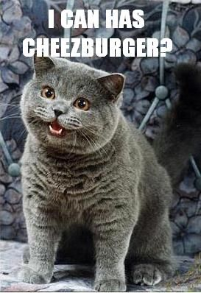

I hope you like cats. And corny memes.

Slide 7
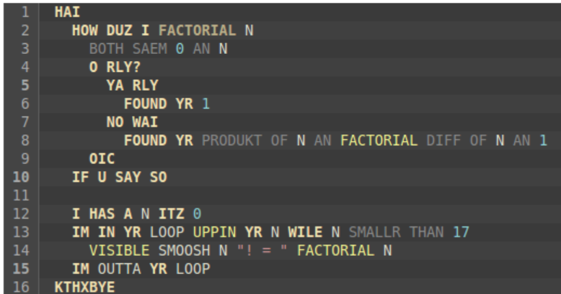
LOLCODE
Good introdukshn:
https://dev.to/crabzmatic/what-is-lolcode-25g9
Offshl spaeck:
https://github.com/justinmeza/lolcode-spec/blob/master/v1.2/lolcode-spec-v1.2.md

Slide 8
Variable declaration and assignment
I has a <varname>
Declares varname as variable
I has a <varname> itz <expr>
Declares varname as variable and assigns value of expr
<varname> r <expr>
Assigns the value of expr to varname

Slide 9
“it” pseudo-variable
Always has the value of the last evaluated expression
Also implicitly used in some statements
Needed for if/then/else

Slide 10
If/then/else
<expr>
o rly? // evaluates “it”
ya rly, <block of code>
no wai, <block of code>
oic

Slide 11
Loops
I’m in yr <loop_label> (uppin|nerfin) yr <varname> (til|wile) <expr>
<block of code>
I’m outta yr <loop_label>
Simple counting loop incrementing/decrementing varname
evaluating arbitrary while/until condition

Slide 12
Switch/case
<expr>, wtf? // also evaluates “it”
omg <expr>
<block of code>
gtfo
omg <expr2>
<block of code>
gtfo
omgwtf
<block of code>
oic
Includes c-style fall-through

Slide 13
Functions
how (iz|duz) i <function_name> [yr <varname1> [ an <varname2>…]]
<block of code>
found yr <expr> // return value
if u say so
// calling functions:
i (iz|duz) <function_name> [yr <expr1> [an yr <expr2> …] mkay
// stores result in “it”

Slide 14
Arithmetic and such
sum of <expr1> an <expr2>
produkt of <expr1> an <expr2>
…
both same <expr1> and <expr2>
diffrint <expr1> and <expr2>
…..
smoosh <expr1> [[an] <expr2> [[an] <expr3> …]] mkay
// concatenates strings and numbers

Slide 15
Troof
win btw true
fail btw false
both of <expr1 > an <expr2> btw && (and)
either of <expr1> an <expr2> btw || (or)
won of <expr1> an <expr2> btw xor

Slide 16
Your task
Write a grammar for selected aspects of LOLCODE
Use the Compilers-Week2 project as a framework

